Slide 1


SDP – 2
Business Group : Supply Chain Management System
190030065 A. BHUVANA SRIJA
190030936 L.RESHMA SREE
190031767 V.BHAVYA CHARITHA

Slide 2
What is Supply Chain Management System?
Supply chain management (SCM) is the active management of supply chain activities to maximize customer value and achieve a sustainable competitive advantage. It represents a conscious effort by the supply chain firms to develop and run supply chains in the most effective & efficient ways possible. Supply chain activities cover everything from product development, sourcing, production, and logistics, as well as the information systems needed to coordinate these activities.

Slide 3

Stages of Supply Chain Management
Plan
1
2
Source
Using supply chain analytics and materials management features in ERP systems, organizations create strategic plans to meet customer demand for product
Organizations identify and select vendors that can supply materials in a streamlined and efficient way according to agreements.
1
Make
3
4
Delivery
In this stage, products are manufactured. It includes scheduling the production, testing, ensuring compliance requirements are followed, packing, storage and release.
2
The delivery stage pertains to logistics and focuses on getting finished goods to consumers, in whatever manner of transportation is needed.
5
Stages
Of
SCM
Return
5
The return stage includes all product returns, including defective products and products that will no longer be supported.
3
4

Slide 4
At their most basic, the key steps in a supply chain include:
Original sourcing or extraction of raw materials
Refining or manufacturing materials into basic parts
Assembling basic parts into finished products
Selling finished products to end users
Delivering finished products to end users or consumers
Benefits of SCM :
Better collaboration
Improved quality control
Higher efficiency rate
Keeping up with demand
Shipping optimization
Reduced overhead costs
Improved risk mitigation
Improved cash flow

Slide 5
Why is supply chain management important?
Effective supply chain management systems minimize cost, waste and time in the production cycle. The industry standard has become a just-in-time supply chain where retail sales automatically signal replenishment orders to manufacturers.
By analyzing partner data, the CIO.com post¹ identifies three scenarios where effective supply chain management increases value to the supply chain cycle:
Identifying potential problems. When a customer orders more product than the manufacturer can deliver, the buyer can complain of poor service. Through data analysis, manufacturers may be able to anticipate the shortage before the buyer is disappointed.
Optimizing price dynamically. Seasonal products have a limited shelf life. At the end of the season, these products are typically scrapped or sold at deep discounts. Airlines, hotels and others with perishable “products” typically adjust prices dynamically to meet demand. By using analytic software, similar forecasting techniques can improve margins, even for hard goods.
Improving the allocation of “available to promise” inventory. Analytical software tools help to dynamically allocate resources and schedule work based on the sales forecast, actual orders and promised delivery of raw materials. Manufacturers can confirm a product delivery date when the order is placed — significantly reducing incorrectly-filled orders.

Slide 6

Our Project Title : Share With Care

Slide 7
Prototype Demonstration: Share With Care

Slide 8
OBJECTIVE OF SWC - ShareWithCare (SWC)
The purpose of our SWC is to make product available to meet customer demand which includes delivery to the appropriate location, on time, in sufficient quantity.
SWC is focused on doing that in the most efficient and effective way.
SWC aims to reduce waste wherever possible.
SWC goals to improve the quality of the customer experience.
Concepts Used:
DS - Data Analysis
Data Interpretation
Data Visualization
MP2 - Floyd Warshall Algorithm (To Track the Order)

Slide 9
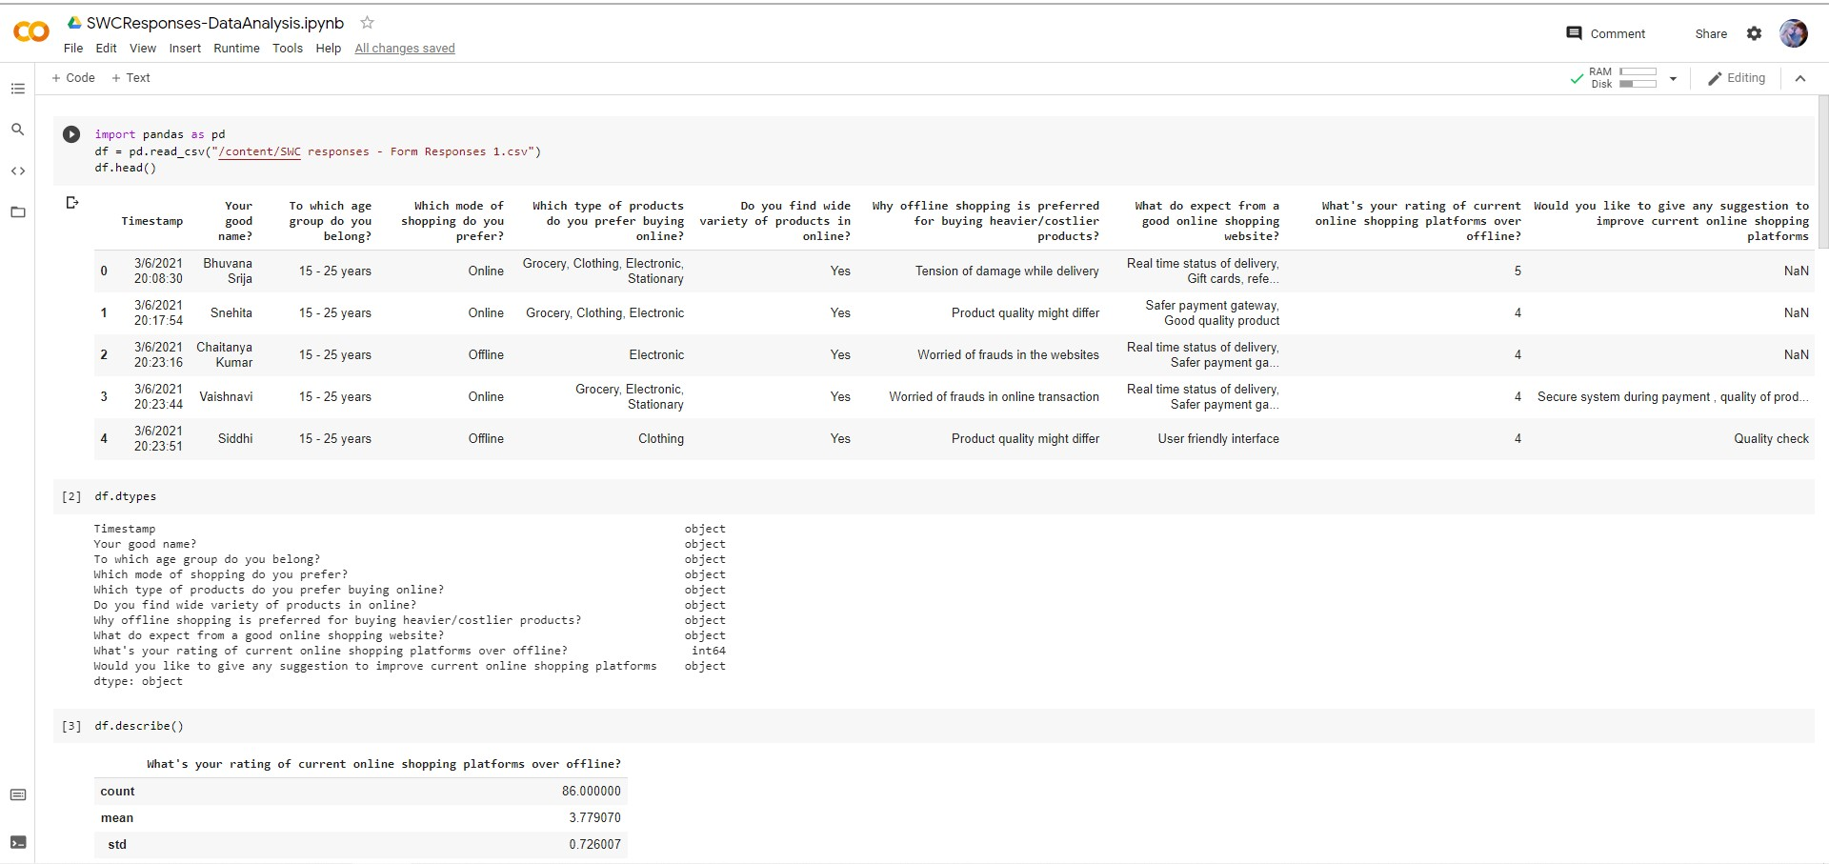

Slide 10
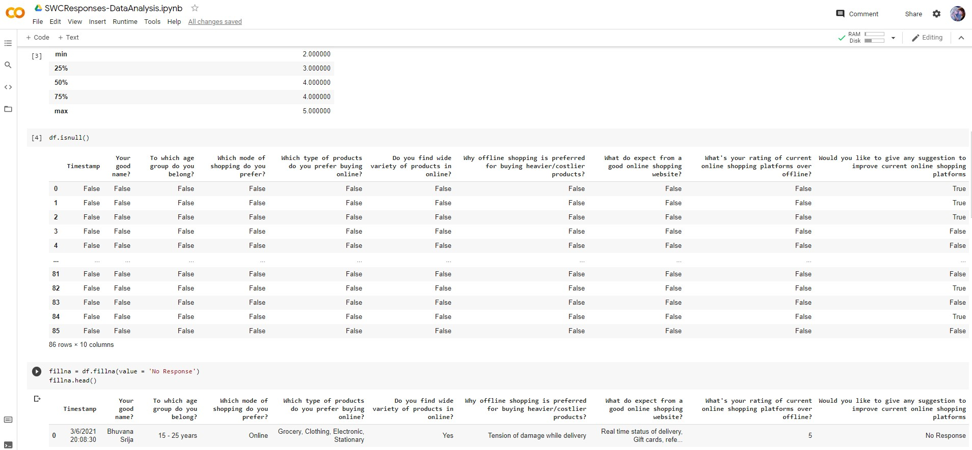

Slide 11
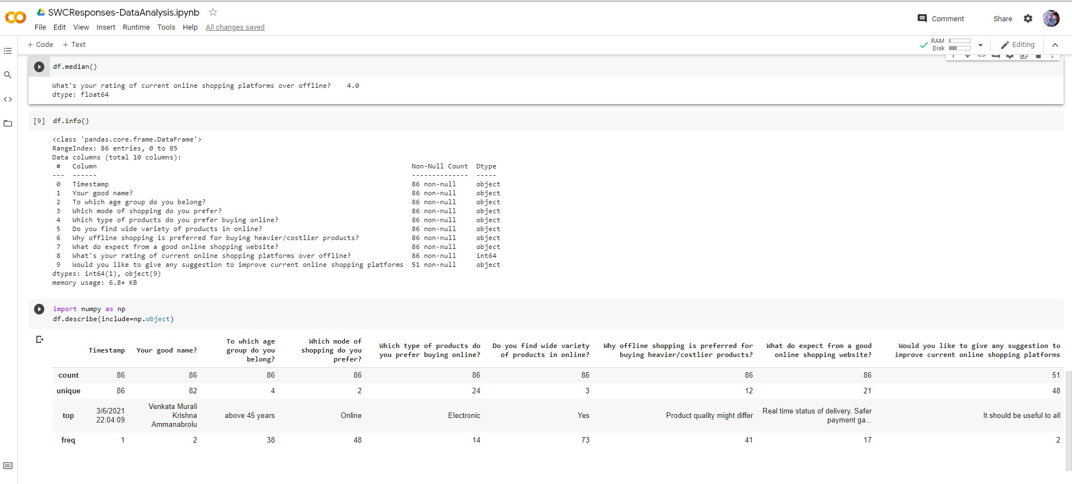

Slide 12
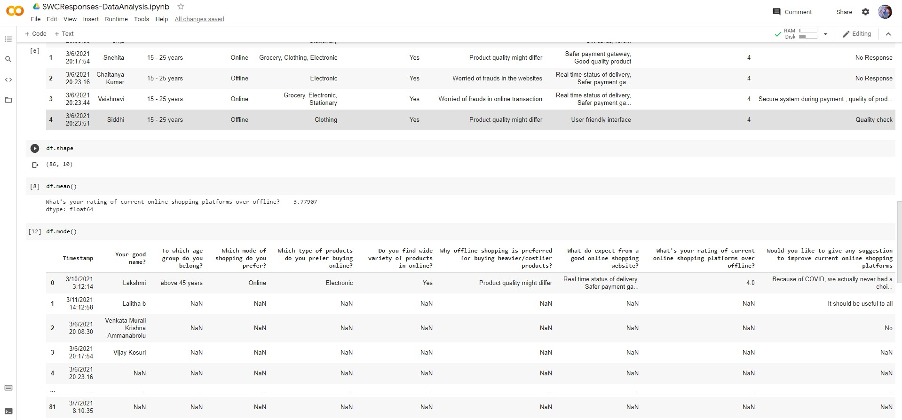

Slide 13
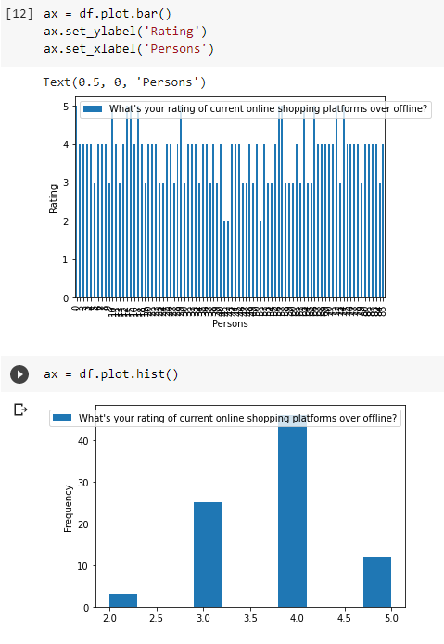
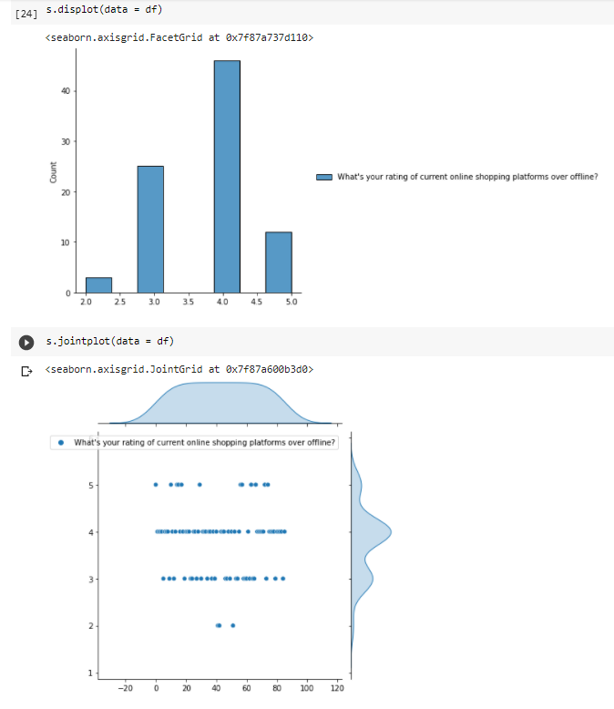

Slide 14
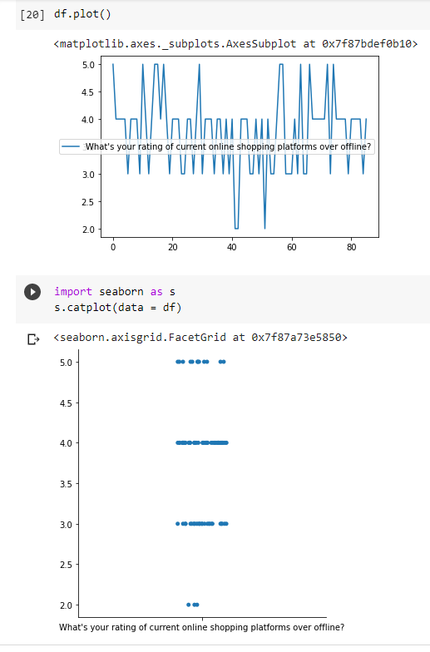

Slide 15
MODULES IN OUR PROJECT - SWC
MODULE 1 - HOME PAGE
MODULE 2 - SIGNUP PAGE (For New Users)
MODULE 3 - LOGIN PAGE (For Registered Users
MODULE 4 - BEST SELLERS DISPLAY PAGE
MODULE 5 - RAW PRODUCTS DISPLAY PAGE
MODULE 6 - PRODUCTS DISPLAY PAGE
MODULE 7 - BRAND SELECTION PAGE
MODULE 8 - PRODUCT SELECTION PAGE
MODULE 9 - PAYMENT PAGE
MODULE 10 - ORDER TRACKING PAGE

